Slide 1
Mu Sigma University
Model Validation
September 2019

Slide 2
Agenda
What is Model Validation?
Common techniques
Regression Validation
Classification Validation
Clustering Validation

Slide 3
Importance of model validation
What is model validation? Why is it done?

Slide 4
Model validation is an essential step which determines if the trained model is performing as expected
Model validation is intended to verify that models are performing in line with their design objectives and business uses. Effective validation:
ensures that models are sound,
identifies potential limitations and assumptions, and
assesses the possible impact of the model
Model validation has two objectives:
Model selection: Estimating the performance of different models in order to choose the best one ^{[1]}
Model assessment: After choosing a final model, estimating its prediction (generalization) error on new data

Slide 5
How is model validation performed?
The validation process can involve:
Analyzing the goodness of fit of the model
Analyzing whether the residuals are random
Checking if the model is not overfitting or under fitting the data
Checking whether the model’s predictive performance does not deteriorate substantially when applied to data that were not used in model estimation

Slide 6
Why is model validation required?
Generalization
Model validation is used for performance assessment of different models and choose the “best fit” model
Overfitting
Model validation is used to detect if a model is overfitting
Parameter Optimization
Model validation is used to tune the parameters to achieve higher accuracy

Slide 7
Common Techniques

Slide 8
Common techniques
The following five techniques are covered in this module:
Holdout
Random Subsampling
Cross Validation a) K Fold Cross Validation b) Stratified K Fold Cross Validation c) Leave-p-Out Cross Validation (LpO CV) d) Leave-One-Out Cross Validation (LOOCV)
Bootstrapping
Out of Sample and Out of Time Validation

Slide 9
Holdout Method
If the data is adequate, the best approach is to randomly split the dataset into three parts:
Training dataset – used to fit models
Validation dataset – used to estimate prediction error for a selected model
Test dataset – used for assessing the generalization error of the final chosen model
A common application of the holdout method is to determine a stopping point for the back propagation error
When should the holdout method be used? In case of huge datasets

Slide 10
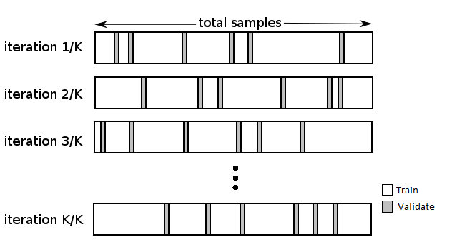
Random Subsampling
Random subsampling, also known as multiple holdout, is based on randomly splitting the data into subsets. The random partitioning of the data is repeated multiple times (denoted by k).
The model is separately trained for each split of data, and errors estimated using the validation set are retained. The final model error is calculated as the average of separate error estimates.
Fig. An illustration of the random subsampling technique

Slide 11
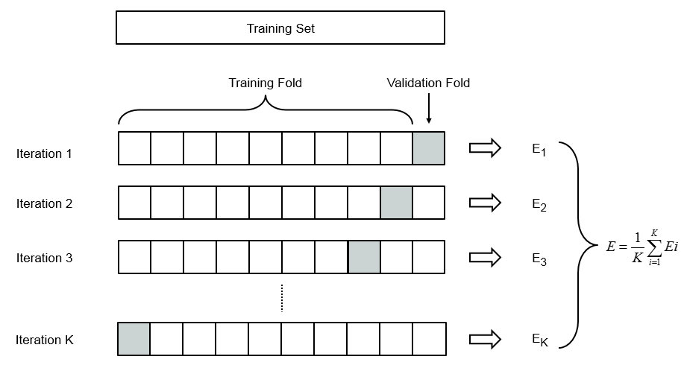
K-Fold Cross Validation
K-fold cross validation is performed when the data is scarce. A part of the available data is used to fit the model, and a different part is used to test it.
The data is split into K equal-sized parts. In the first iteration, the model is trained using the first K−1 parts of the data, whereas the K^{th} part is used for validation i.e. calculating the prediction error. This “folding” process is repeated for each value of k (1, 2, ….. K) in each iteration. The average of K estimates is finally calculated as the prediction error.
Fig. An illustration of K Fold Cross Validation

Slide 12
Stratified K-Fold Cross Validation
In stratified k-fold cross validation, folds are selected is such a way that the mean response value is approximately equal in all the folds. In the case of binary classification, this would mean that each fold contains approximately the same proportions of the two class labels, thus ensuring that the training and validation subsets are true depictions of the original dataset.
The biggest advantage of stratified validation is that it reduces selection bias. Stratifying the entire population before applying random sampling methods helps to create a sample which accurately reflects the population being studied.
When should stratified k-fold cross validation be used? When the target variable is unevenly distributed across classes

Slide 13
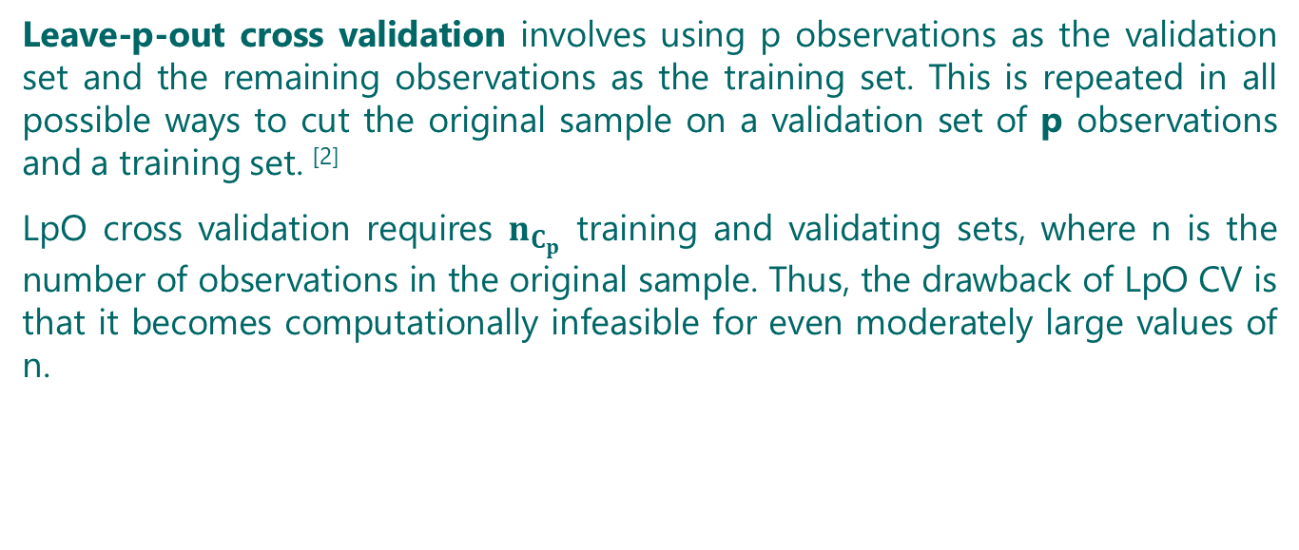
Leave-p-Out Cross Validation (LpO CV)
Leave-p-out cross validation involves using p observations as the validation set and the remaining observations as the training set. This is repeated in all possible ways to cut the original sample on a validation set of p observations and a training set. ^{[2]}
LpO cross validation requires $n_{C_{p}}$ training and validating sets, where n is the number of observations in the original sample. Thus, the drawback of LpO CV is that it becomes computationally infeasible for even moderately large values of n.

Slide 14
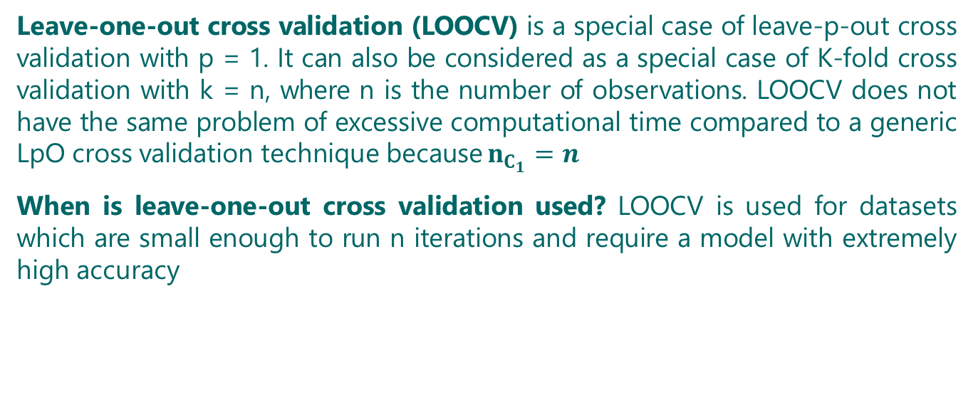
Leave-One-Out Cross Validation (LOOCV)
Leave-one-out cross validation (LOOCV) is a special case of leave-p-out cross validation with p = 1. It can also be considered as a special case of K-fold cross validation with k = n, where n is the number of observations. LOOCV does not have the same problem of excessive computational time compared to a generic LpO cross validation technique because $n_{C_{1}}=n$
When is leave-one-out cross validation used? LOOCV is used for datasets which are small enough to run n iterations and require a model with extremely high accuracy

Slide 15
Bootstrapping
Bootstrapping is a resampling technique which involves selecting m observations are selected out of a dataset with n observations, as the training dataset. The remaining (m-n) observations are used for validation. This process is repeated k times. The true error is estimated as the average error of all k iterations.
When is bootstrapping use?
Bootstrapping is ideal for very small datasets or for special or rare datasets
Bootstrapping is generally employed when randomness is required

Slide 16
Out of Sample and Out of Time Validation
In out of sample validation, a dataset which is not part of the training dataset is used for validation. For example – a model trained on observations from North America is validated on observations from South America.
Out-of-time validation involves a similar concept as out-of-sample validation, except that the validation is performed using a dataset in a later timeframe compared to the training dataset on which the model was fit. For example – A model trained on records from Jan 2016 to Oct 2016 and is validated using records from Nov 2016 to Dec 2016.
When to use out-of-time validation? This validation technique is used when a change over time is the concern

Slide 17
In this section, validation techniques specific to the class of algorithms being used have been discussed
Machine Learning
Supervised
Unsupervised
Regression
Classification
Clustering
The boxes at the lowest level can be used for navigating to the respective sections

Slide 18
Back to ML validation
Regression Validation

Slide 19
Introduction to regression validation
Regression validation is the process of deciding whether the numerical results quantifying hypothesized relationships between variables, obtained from regression analysis, are acceptable as descriptions of the data. The validation process can involve ^{[3]}
Analyzing the goodness of fit of the regression ^{[3]}
Analyzing whether the regression residuals are random ^{[3]}
Checking whether the assumptions of modelling algorithm are met ^{[3]}
Checking whether the model’s predictive performance deteriorates substantially when applied to data that were not used in model estimation (model generalization) ^{[3]}

Slide 20
Regression validation methodology
The general approach for validating regression models is:
Randomly divide the dataset into training and validation samples
Apply regression algorithm on the training dataset
Use the fitted model to score all records present in validation dataset
Calculate and compare different validation measures for both the training and the validation sample
The measures computed for training sample should be in agreement with the acceptable values of the respective measure
Note: The steps above are common with holdout validation. Apart from holdout, other methods like K-fold cross validation, LOOCV, LpO CV, random resampling and bootstrapping can also be used.

Slide 21
Commonly used regression validation measures
Root Mean Square Error (RMSE): RMSE is calculated as the sum of the standard deviation of the difference between each predicted and observed value
Coefficient of Determination (R²): It is the proportion of the variance of the dependent variable which is predicted using the independent variable(s). R² value varies in the range of [0, 1], with a higher value denoting a better model. However, it must be noted that a very high R² hints overfitting.
Adjusted R² : A drawback of R² is that it is biased towards the number of variables, i.e. a model with more independent variables appears to have a better R² simply because it has more terms. Adjusted R² is a modified version which accounts for the number of variables in the model.

Slide 22
Back to ML validation
Classification Validation

Slide 23
Introduction to classification validation
Classification validation is concerned with the quality of fit and generalization. Classification validation is of prime importance as most classification algorithms have an innate tendency to overfit training data.
The two main dimensions of a model’s performance are:
Discrimination: It refers to a model’s ability to distinguish class outcomes correctly. A perfect discrimination results in non-overlapping distributions of predicted probabilities for the sub-groups (classes). A few examples of discrimination measures are – sensitivity, specificity, AUC – ROC.
Calibration: Calibration is a measure of how close the predicted probabilities are to the observed rate of the positive outcome for any given configuration of the independent variables of the model. A few examples of calibration measures are – Hosmer and Lemeshow χ² , GoF test, and bias.

Slide 24
Classification validation methodology
Randomly split the dataset into training and validation samples – Holdout, bootstrapping and K-fold cross validation are few common techniques used for data splitting
Apply the classification algorithm on the training dataset
Use the fitted model to estimate the probability of a positive outcome for each of the records in both the training and the validation samples
Calculate and compare different validation measures for both the training and the validation samples
Repeated steps 1 through 4 multiple times to increase randomness in the two datasets and improve the model’s fit

Slide 25
Popular classification validation measures
Accuracy: The number of correctly predicted observations out of the total number of observations
Area under the ROC curve (AUC – ROC): A receiver operating characteristic or ROC curve, is a graphical plot which illustrates the diagnostic ability of a classifier as its discrimination threshold is varied. The ROC curve is the plot between sensitivity and (1- specificity). AUC lies within the interval [0, 1]. ^{[4]}
F–measure: The F-measure combines the concepts of precision and recall. Its value lies within the interval [0, 1], with a larger value indicating higher classification quality.

Slide 26
Back to ML validation
Clustering Validation

Slide 27
Introduction to clustering validation
Clustering validation is measures the quality of clusters generated by a clustering algorithm. Given the partitioning of a data set, it attempts to identify the following:
Clustering tendency of the data – Clustering tendency assessment determines whether a given dataset contains meaningful clusters i.e. the data has a non-random structure. This should be performed as an initial test, before attempting clustering.
Cluster structure – Adhesion and Cohesion
The best clustering algorithm compared to others
Types of Cluster Validation:
Relative clustering validation
Internal clustering validation
External clustering validation
Clustering stability validation

Slide 28
Clustering validation methodology
Split the data into two subset of almost similar size, dataset ‘A’ for training and dataset ‘B’ for validation
Apply clustering algorithm on training dataset ‘A’ to get ‘c’ clusters
Score records in dataset ‘B’ to clustering model derived from dataset ‘A’
Apply the same clustering algorithm on validation dataset ‘B’ to get ‘c’ clusters
Find corresponding clusters by mapping ‘c’ clusters created in step-4 to ‘c’ clusters created in step-2
For every record in the dataset ‘B’, cluster labels from step-3 and step-5 are then compared

Slide 29
Clustering validation measure – Adjusted Rand Index (ARI)
It is preferred that models have a high agreement between two clusters for observations in ‘B’. The Adjusted Rand Index (ARI) (or any similar metric such as Rand Index, Meila’s VI, etc.) is used to calculate the agreement between two cluster sets. ARI value ranges between [-1, +1], with a high value denoting greater agreement:
1 stands for perfect match while 0 stands for random labeling
Negative ARI denotes the agreement is less than what is expected from a random result
A high agreement indicates the ability of the clustering model to predict the clusters of another dataset sampled from the same source. This proves that the population is stable and model is generalized.

Slide 30
Internal cluster validation
Internal validation measures reflect the compactness, the connectedness and the separation of the cluster partitions, i.e. the average distance within clusters should be as small as possible; and the average distance between clusters should be as large as possible.
Compactness measures evaluate how close the objects within the same cluster are, hence lower the compactness better the model
Separation measures determine how well-separated a cluster is from other clusters, i.e. higher the separation better the model
Connectivity corresponds to what extent points are placed in the same cluster as their nearest neighbors in the data space. Connectivity has a value between [0, ∞) and should be minimal.

Slide 31
Popular internal cluster validation measures
Silhouette Index/Width: Silhouette index measures how well an observation is clustered and it estimates the average distance between clusters ^{[5]}. The silhouette plot displays a measure of how close each point in one cluster is to points in neighboring clusters. Silhouette width ranges in the interval [-1, 1] and it should be maximized.
Davies-Bouldin Index: This index aims to identify sets of clusters that are compact and well separated. Smaller value of DB indicate better clustering.^{[6]}
BIC Index: The Bayesian information criterion (BIC) is devised to avoid overfitting. The BIC index takes into account both fit of the model to the data and the complexity of the model. A model having a smaller BIC is preferred.

Slide 32
External cluster validation
In external validation, clustering results are validated based on data that was not used for clustering, such as known class labels and external benchmarks. Such benchmarks consist of a set of pre-classified items, and these sets are often created by experts. Thus, benchmark sets can be considered as a gold standard for evaluation. External cluster validation measures how close cluster results are to predetermined benchmark classes.
A few popular external cluster validation measures are –
Purity,
Entropy, and
Rand Index

Slide 33
Clustering stability validation
Stability measures compare the results from clustering on the entire dataset to clustering on removing each column, one at a time. This is performed because of the assumption that samples in the same cluster should possess similar pattern vectors for additional features that were not considered in the clustering process.
Stability measures work especially well if input variables are highly correlated, which is often the case in real world data. In all cases, the average is taken over all the deleted columns, and all measures are minimized.
Two popular cluster stability validation measures are –
Average Proportion of Non-overlap (APN): APN measures the average proportion of observations not placed in the same cluster. APN lies in the interval [0, 1], with values close to zero corresponding to highly consistent clustering results.
Average Distance between Means (ADM): ADM measures the average distance between cluster centres. ADM has a value between 0 and ∞, with smaller values being preferred.

Slide 34
References
[1] https://www.cc.gatech.edu/~afb/classes/CS7616-Spring2014/slides/CS7616-07.pdf
[2] http://www.voidcn.com/article/p-ecqvisjm-em.html
[3] https://infogalactic.com/info/Regression_validation
[4] https://www.analyticsvidhya.com/blog/2019/08/11-important-model-evaluation-error-metrics/
[5] https://www.oreilly.com/library/view/matlab-for-machine/9781788398435/3fdcc6b9-86d1-4207-ab2b-446323b67b88.xhtml
[6] https://arxiv.org/pdf/1307.6814.pdf

